Slide 1
WELDING
Welding is a fabrication that joins materials, usually metals or thermoplastics, by melting the workpiece and adding a filler material to form a pool of molten material (the weld pool) that cools to become a strong joint, with pressure sometimes used in conjunction with heat, or by itself, to produce the weld.

Slide 2
List of welding processes
Arc welding
Electrogas welding
Electroslag welding
Flux cored arc welding
Gas metal arc welding
Gas tungsten arc welding
Plasma arc welding
Submerged arc welding MIG,TIG welding
Oxyfuel gas welding
Air acetylene welding
Oxyacetylene welding
Thermite welding

Slide 3
Resistance welding
Flash welding
Pressure-controlled resistance welding
Other welding
Electron beam welding
Electroslag welding
Flow welding Induction welding
Laser beam welding

Slide 4
Arc Welding
Arc welding is a type of welding that uses a power supply to create an electric arc between an electrode and the base material to melt the metals at the welding point.
Limited to welding ferrous materials
Special electrodes cast iron, nickel, aluminium, copper and other metals can also be welded.
Versatile ,Portability, cheap.

Slide 5
Essentials
Power Supply
Electrodes
Metals to be Welded

Slide 6
Power Supply
Constant current power supply
Constant voltage power supply
Voltage is directly related to the length of the arc,
Current is related to the amount of heat input.
Typical parameters 50 to 500 amps, depending on the size of weld required; 100 amps is typical for manual welders.
Voltage 20 to 50 volts
Energy consumption/Kg of metal deposited
AC- 3-4 Kwh DC- 6-10 Kwh

Slide 7
Power Supply contd.
Constant current power supply- for manual welding processes because they maintain a relatively constant current even as the voltage varies. In manual welding, it can be difficult to hold the electrode perfectly steady, and as a result, the arc length and thus voltage tend to fluctuate.
Constant voltage power supplies hold the voltage constant and vary the current, automated welding processes . arc length is kept constant, since any fluctuation in in the distance between the wire and the base material is quickly rectified by a large change in current.

Slide 8
Polarity Of Electrode
Positively charged anode will have a greater heat concentration . If the electrode is positively charged, it will melt more quickly, increasing weld penetration and welding speed.
Negatively charged electrode results in more shallow welds.
Non-consumable electrode processes, such as gas tungsten arc welding, can use either type of direct current (DC), as well as alternating current (AC).
Alternating current rapidly moves between these two, resulting in medium-penetration welds.
Heat generated
66% anode
33% cathode

Slide 9
Polarity selection
Thick and high conductivity materials – Anode
Thin and low conductivity materials -- Cathode

Slide 10
Electrodes
Compatible with the base material
Covered with a flux that protects the weld area from oxidation and contamination by producing CO₂ gas during the welding process. The electrode core itself acts as filler material,
Consumable electrode
Non-consumable electrode (thin section, high accuracy)

Slide 11
Composition of Electrode
Electrode comprising
A metal to be deposited on a substrate
Flux composition :
1. Magnesium-aluminum alloy having an aluminum content of 20 to 80 percent alloy present in said flux in the amount of 5 to 35 percent by weight
2. Calcium fluoride 30 to 80 percent based on the weight of said flux;
3. Hematite 3 to 30 percent by weight;
4. Silica and/or manganese less than 10 percent based on the weight of said flux;
5. Titanium less than 1.00 percent, based upon the weight of said flux;
6. Zirconium from 0.005 to 0.200 weight percent, based on the weight of said flux; and
7. Boron in an amount less than 0.060 weight percent, based upon the weight of said flux.

Slide 12
Parameters
Thickness(mm) Elect. Dia I V
3-6 3.2 100-150 18-22
6 4 140-200 20-24
9 6 200-300 21-25
16 8 275-350 23-27
20-25 9 375-450 24-28

Slide 13
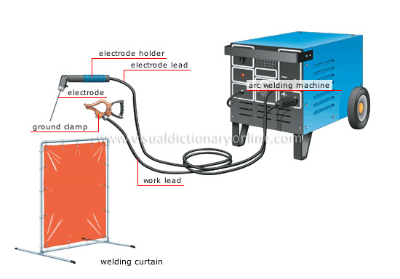
Arc Welding Machine

Slide 14
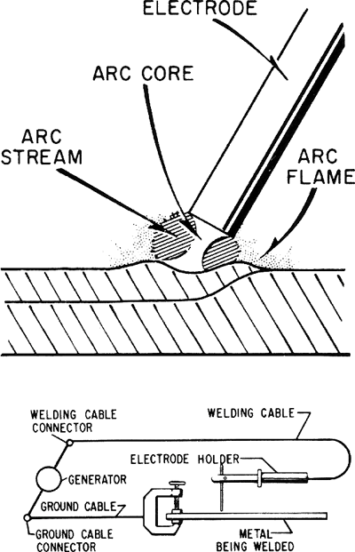
Process

Slide 15

Characteristic curve
40
30
20
10
50
100
150
200
250
300
Current I

Slide 16
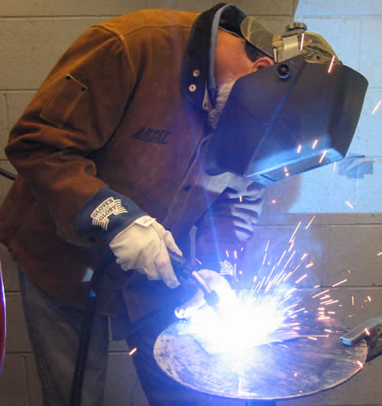

Slide 17
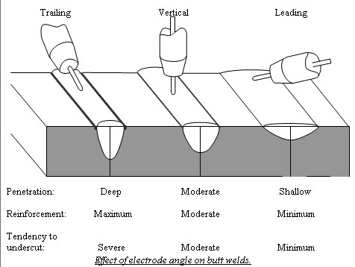
Electrode Angles

Slide 18
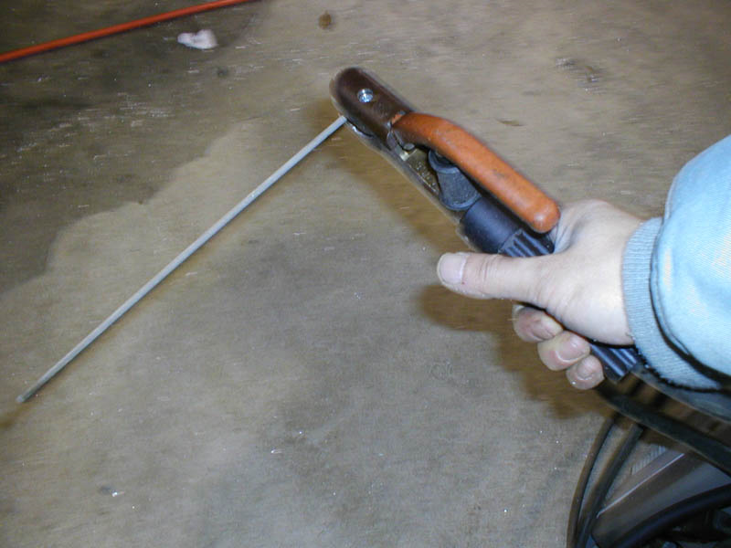
Electrode Holder

Slide 19
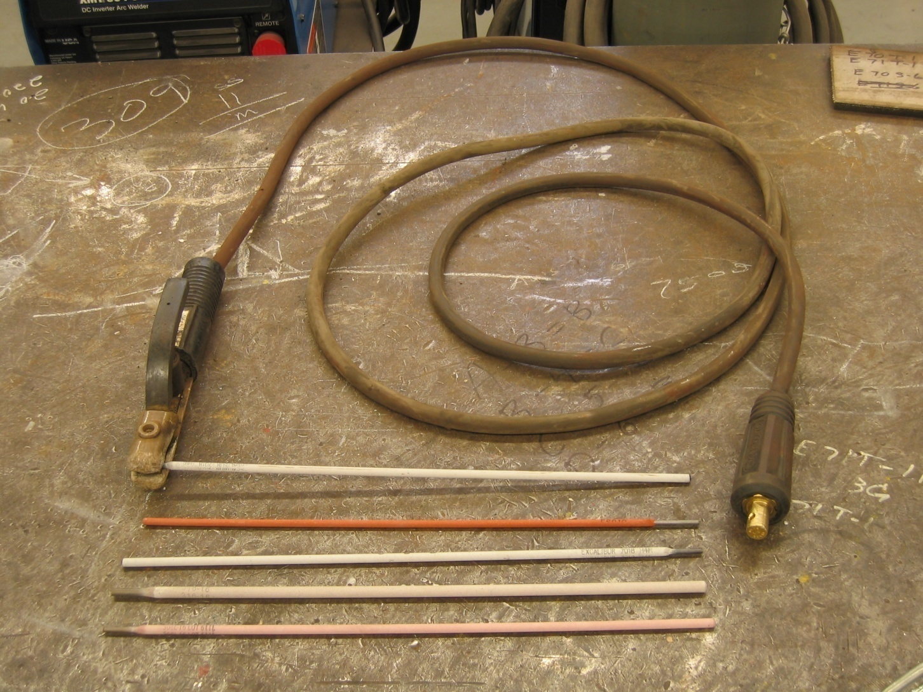
Different Electrodes

Slide 20
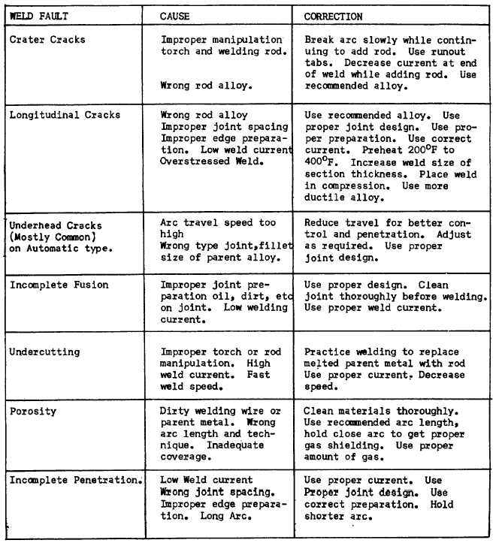
Welding Defects

Slide 21
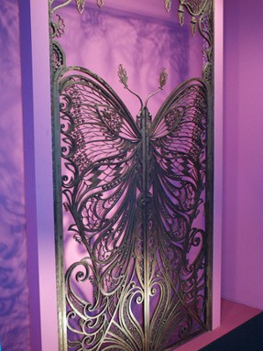
Welding- An art

Slide 22
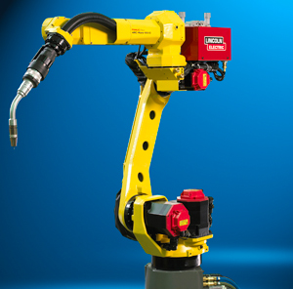
Robots in Welding

Slide 23
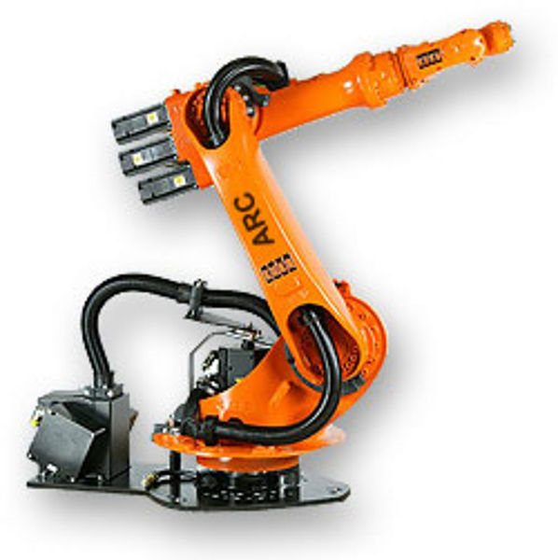

Slide 24
Safety issues
Heat and Sparks (Burn)
Eye Damage (UV Rays)
Inhaled matter
Protective clothing
Leather Gloves
Welding Goggles and Helmets
Limiting the amount of oxygen in the air and keeping combustible materials away from the workplace

Slide 25
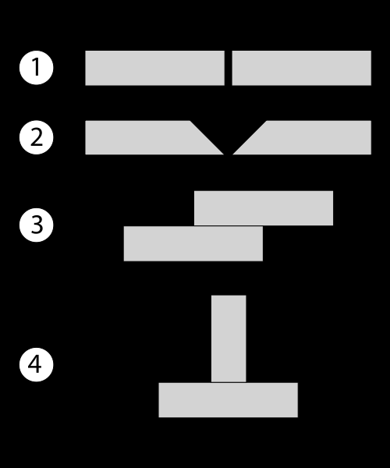
Weld Joints
Common welding joint types – (1) Square butt joint, (2) V butt joint, (3) Lap joint, (4) T-joint

Slide 26
Heat Input Calculations
Heat input for arc welding process
Q=(V x I x 60 x efficiency) /(S x 1000)
where Q = heat input (KJ/mm), V = voltage (V), I = current (A), and S = welding speed (mm/min). The efficiency is dependent on the welding process used, with shielded metal arc welding having a value of 0.75, gas metal arc welding and submerged arc welding, 0.9, and gas tungsten arc welding, 0.8.

